Slide 1
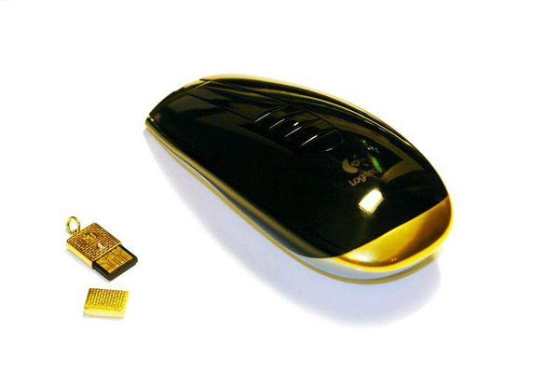
Computer Mouse
Lecturer: Ms. Vu Quynh Hoa
Group members:
Le Ngoc Long
Nguyen Van Hung

Slide 2

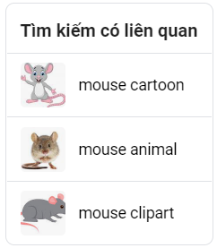
Mouse
History
What is a computer mouse?
Types of computer mouse
Button Function

Slide 3
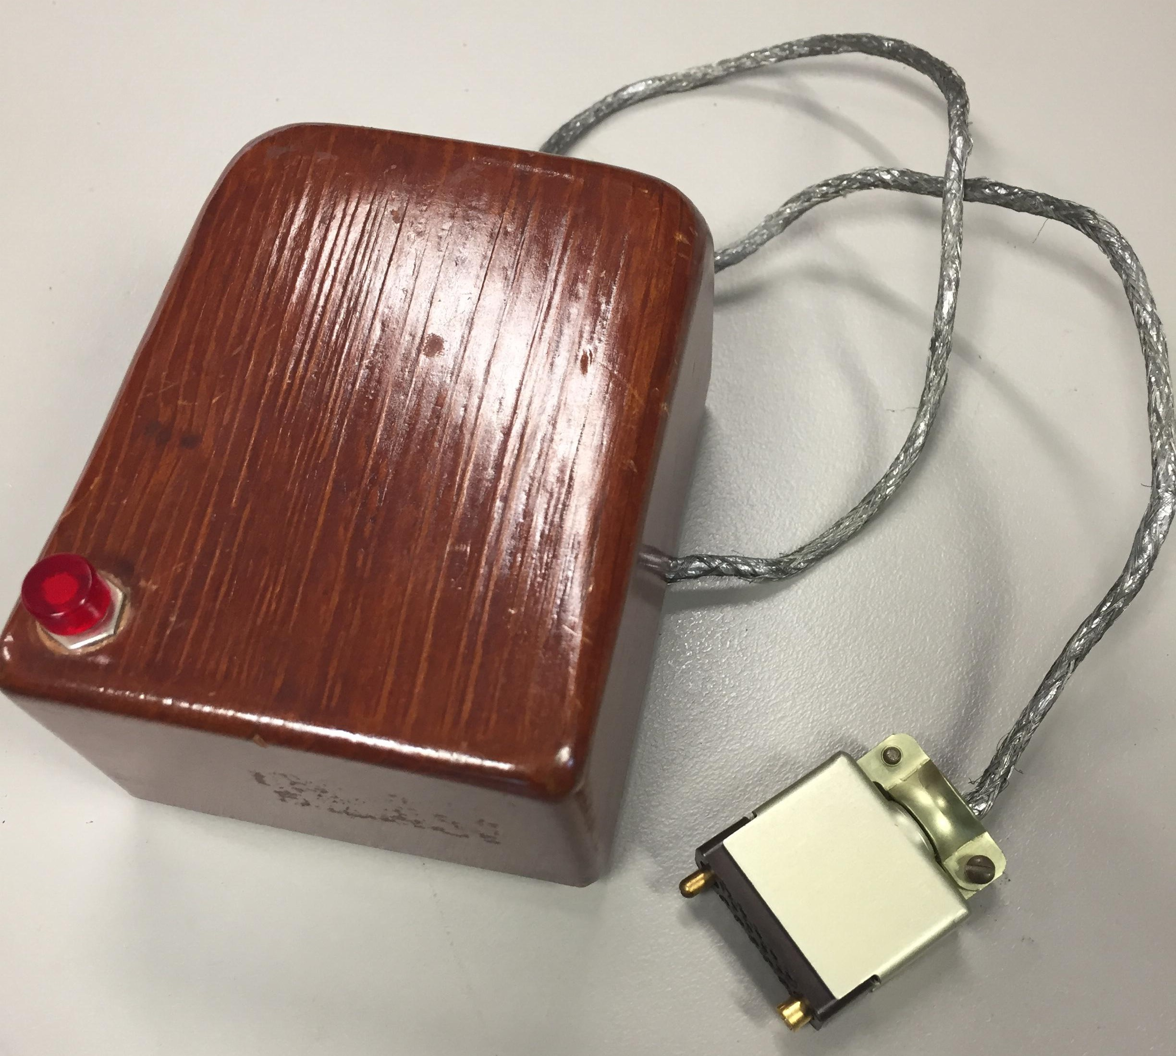
What is a computer mouse?
The first computer mouse prototype
A computer peripheral
How to use
Ports: COM, PS/2, USB and wireless connection.

Slide 4
History of computer mouse
Concept of the computer mouse
Two Buttoned Mouse Designed
First Cordless mouse Developed
1961
1964
1974
1987
2001
2008
First Computer Mouse Prototype
First ergonomically designed mouse
Another Cordless Mouse
www.free-powerpoint-templates-design.com

Slide 5
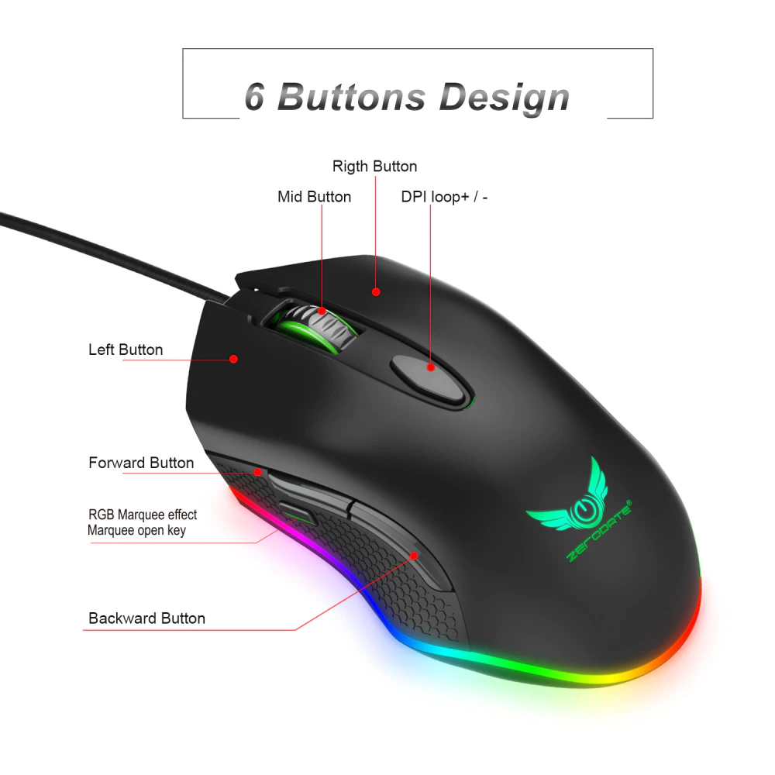
Mouse button function
Left button
Right button
Scroll button
Mid button
DPI +/- button
Forward/backward button

Slide 6
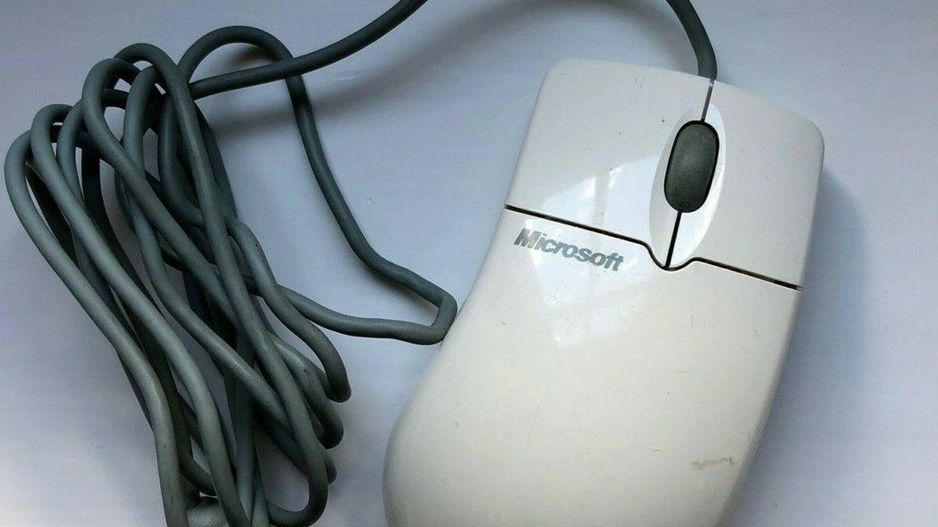
Types of computer mouse
Ball Mouse

Slide 7
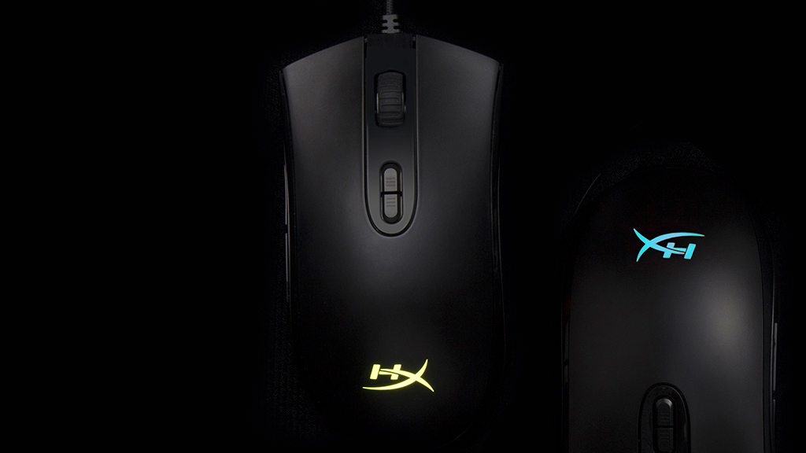
Types of computer mouse
Optical
mouse

Slide 8
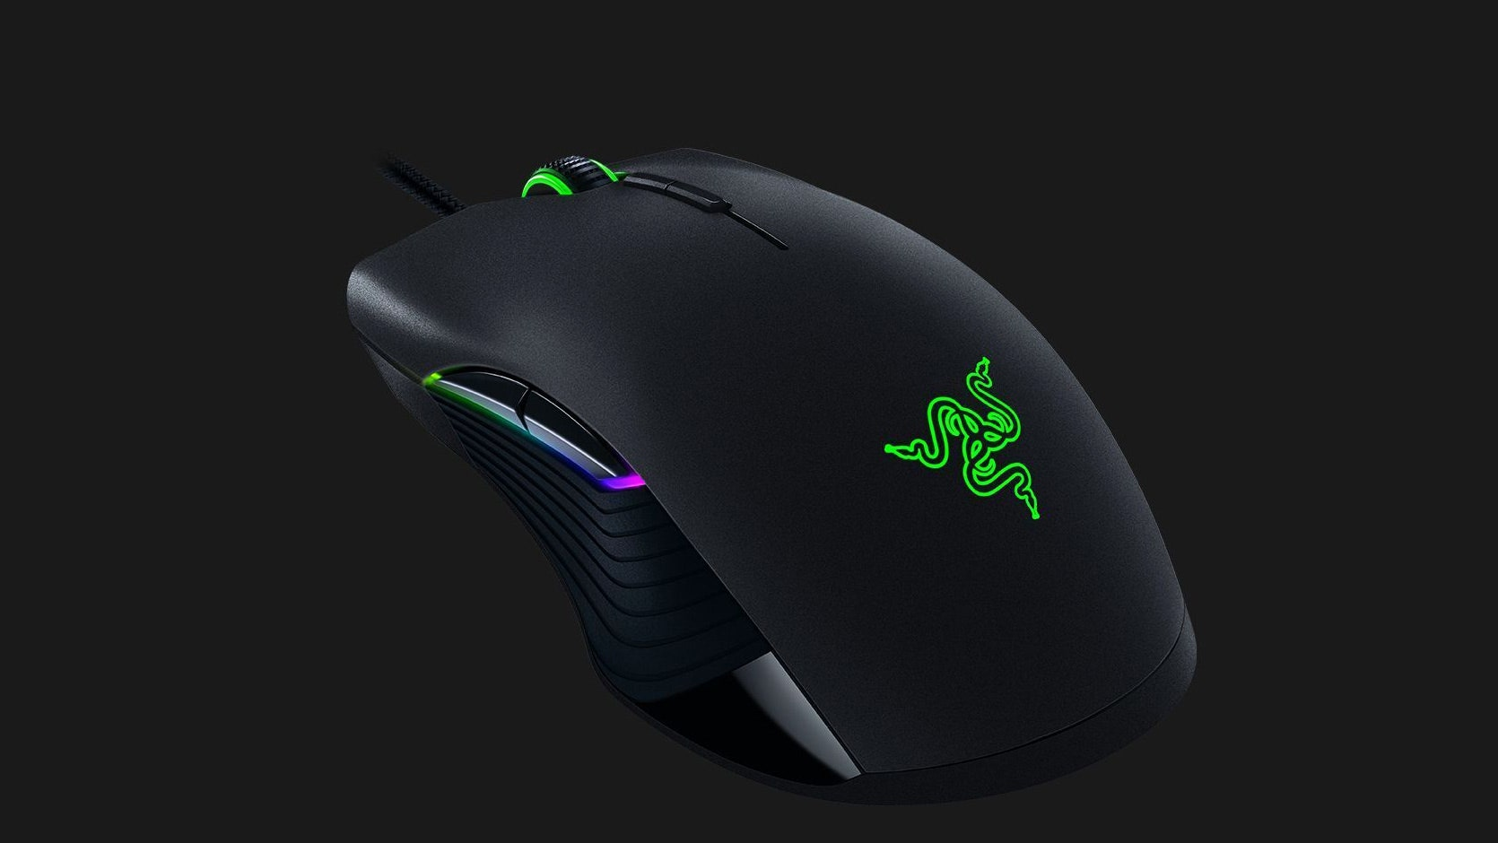
Types of computer mouse
Laser mouse

Slide 9
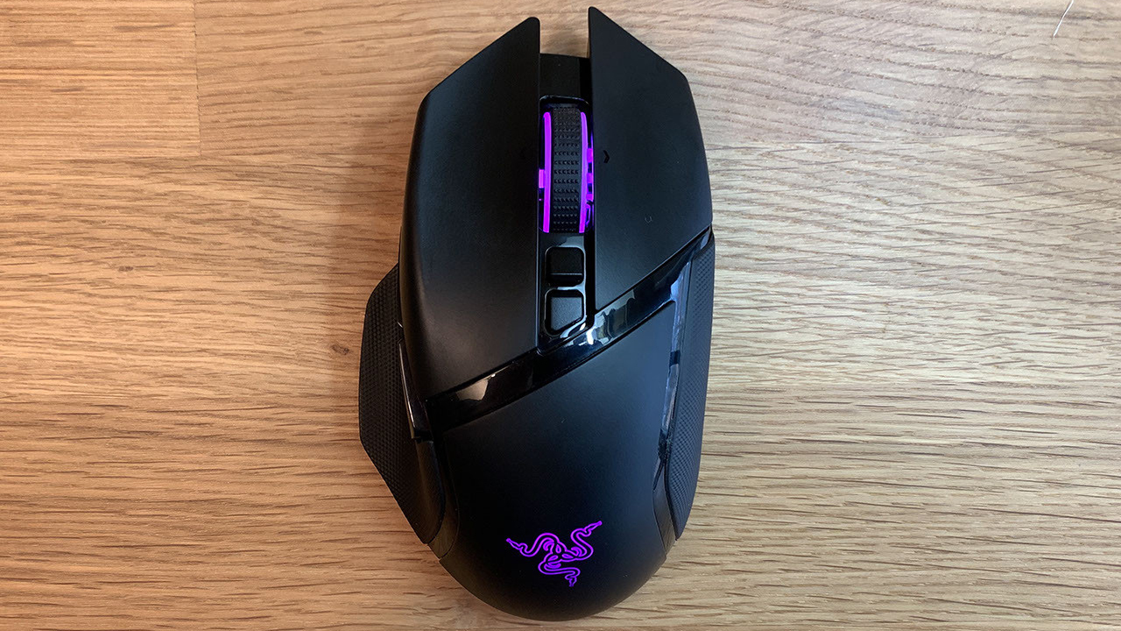
Types of computer mouse
Wireless mouse

Slide 10
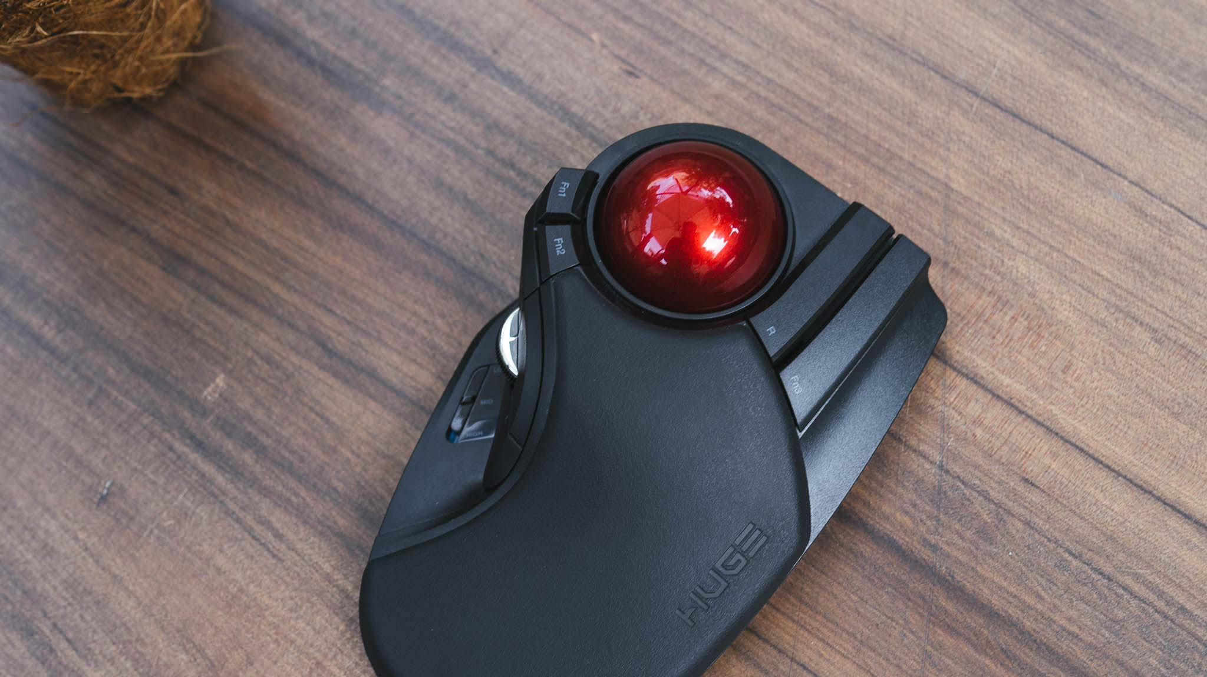
Types of computer mouse
Trackball Mouse

Slide 11

THANK YOU FOR LISTENING

